Slide 1
15-5-25

Slide 2
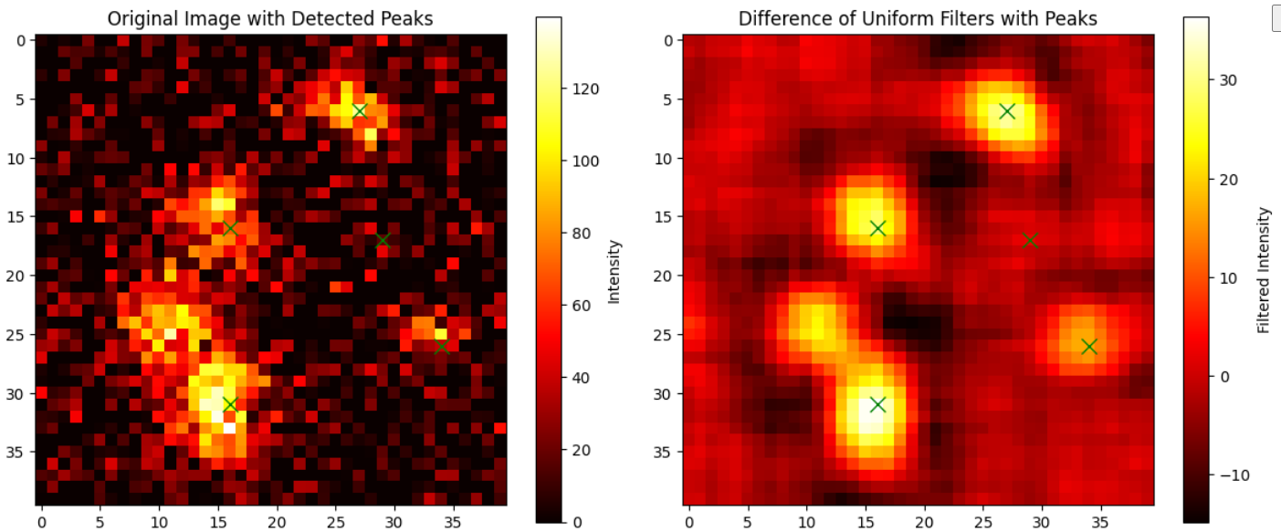
Uniform filter

Slide 3
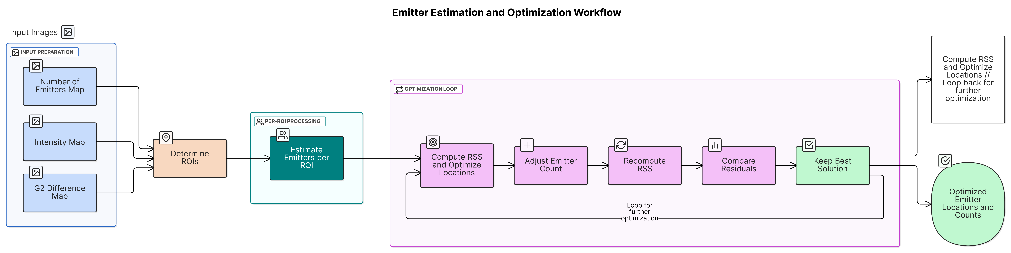
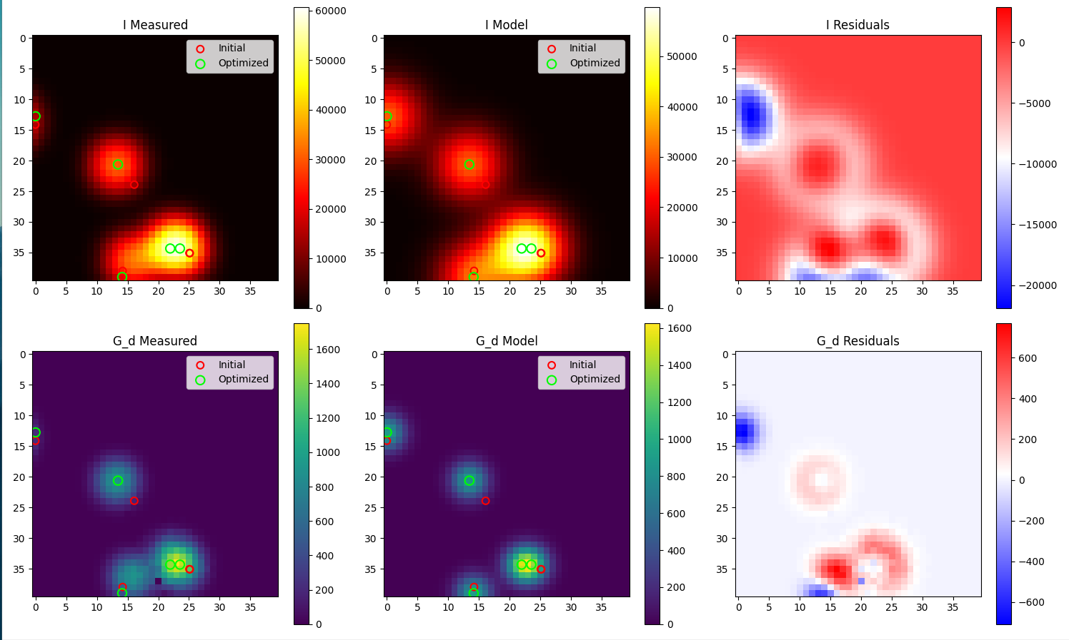
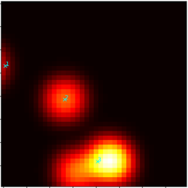
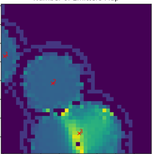
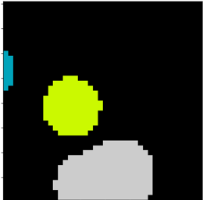
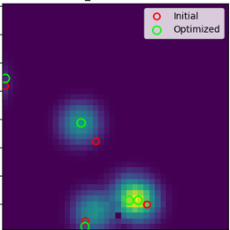
Localization workflow
Notes:
Determines ROI using filtering.
Estimate emitter count per ROI by taking maximum over the ROI.
Use centroids of ROI as initial positions with then umber of emitters being equal to the count found in (2). Then optimizing with RSS, optimizing with a small change in the emitters/ROI and comparing.

Slide 4
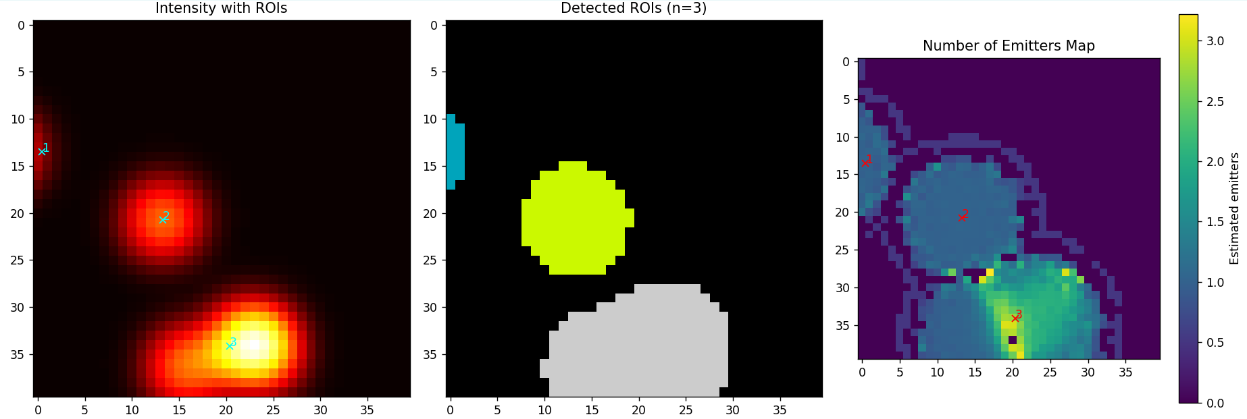

Slide 6
Algorithm
Test: 5 emitters / um^2

Slide 7
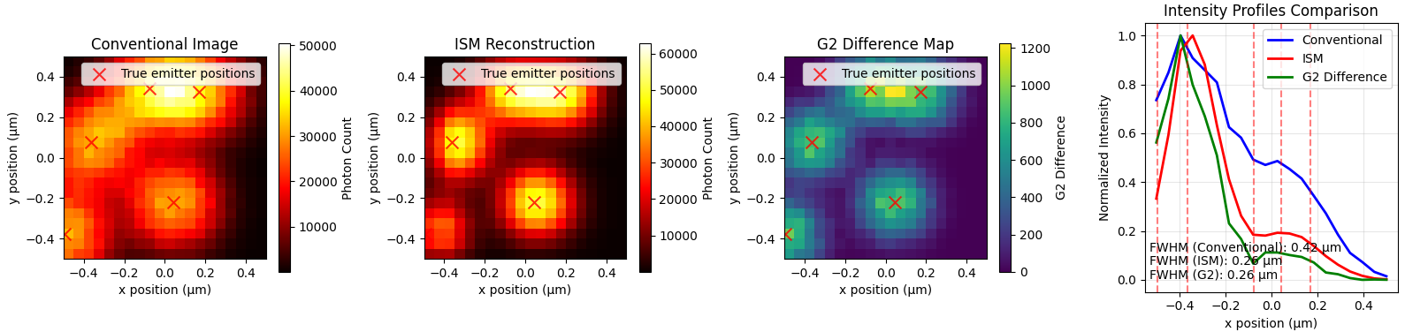
Example

Slide 8
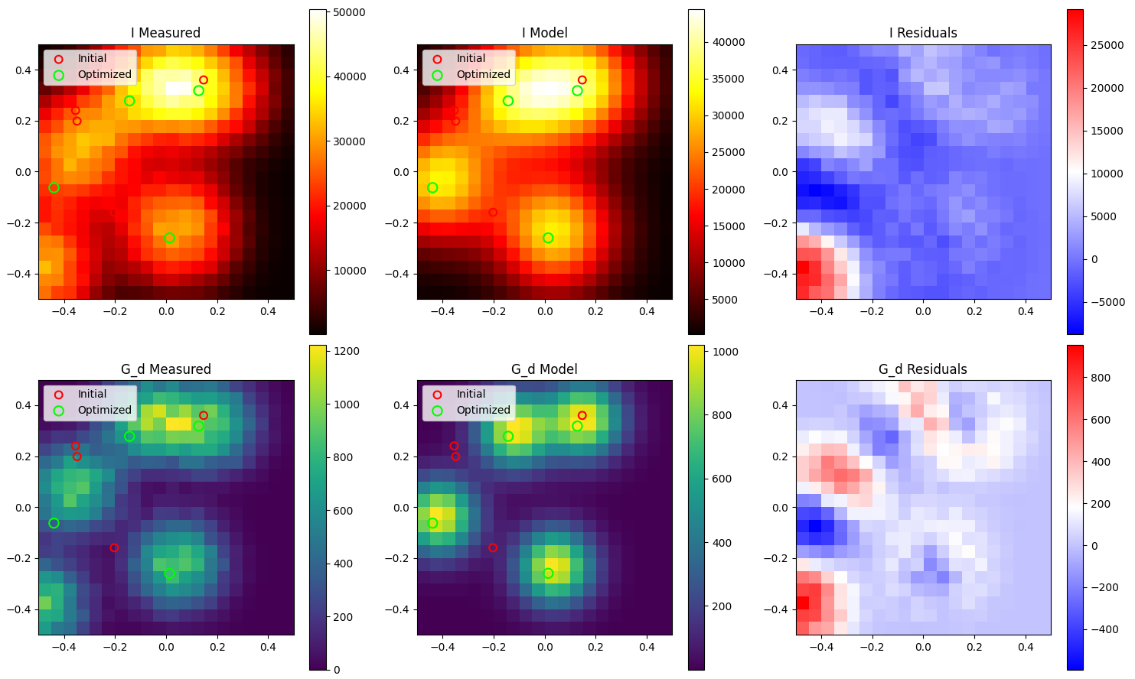
Without varying n/ROI

Slide 9
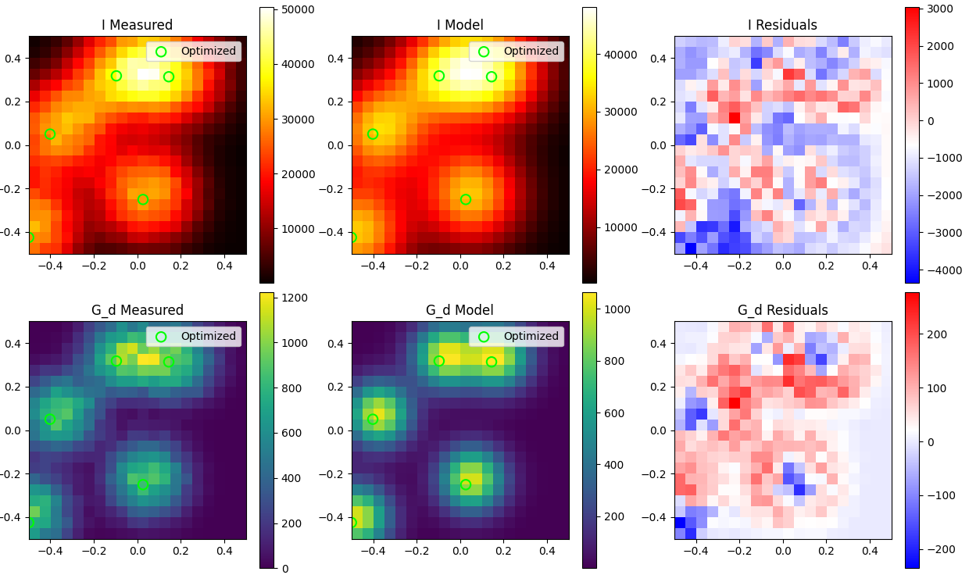
With varying n/ROI

Slide 10
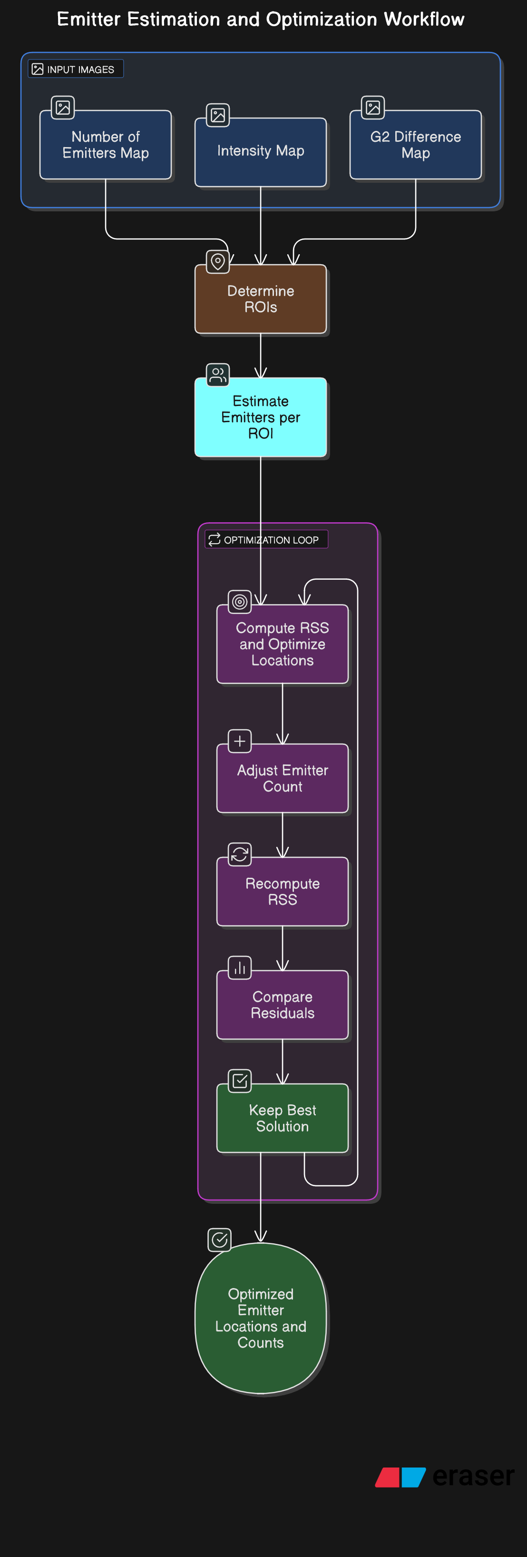

Slide 11
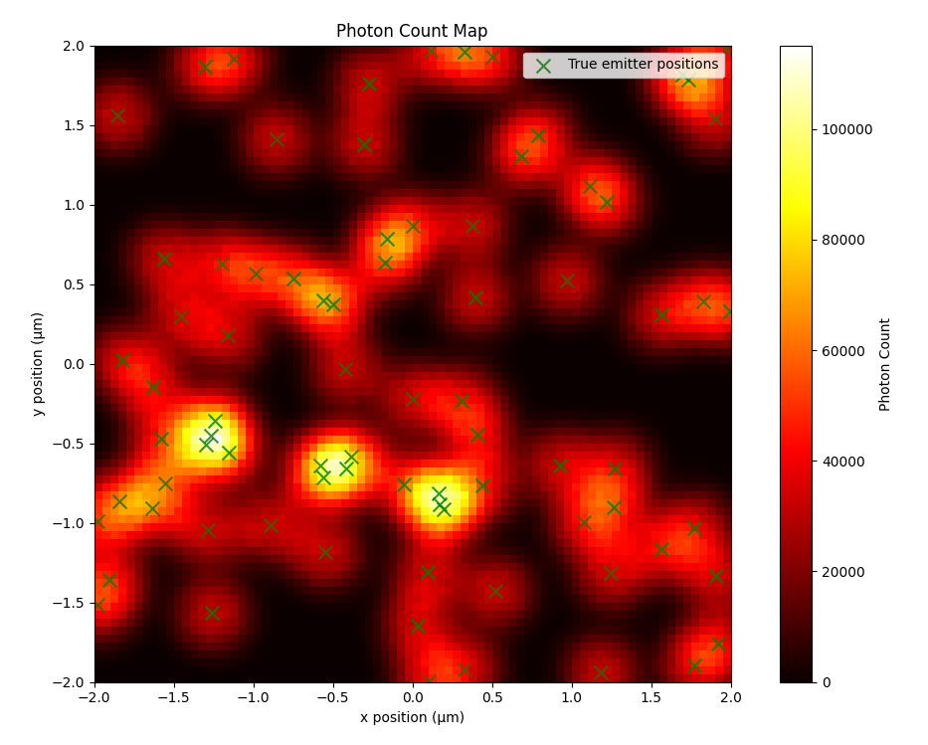
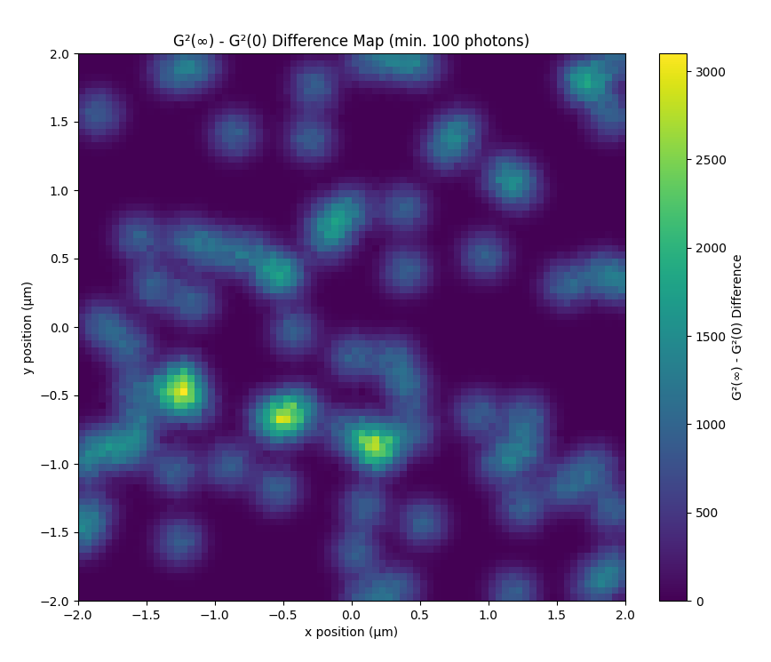
Larger field of view?

Slide 12
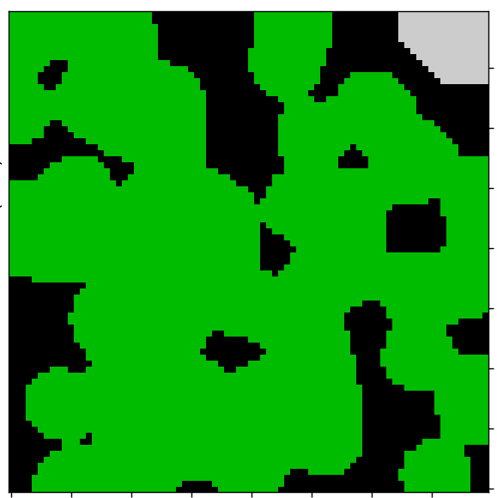
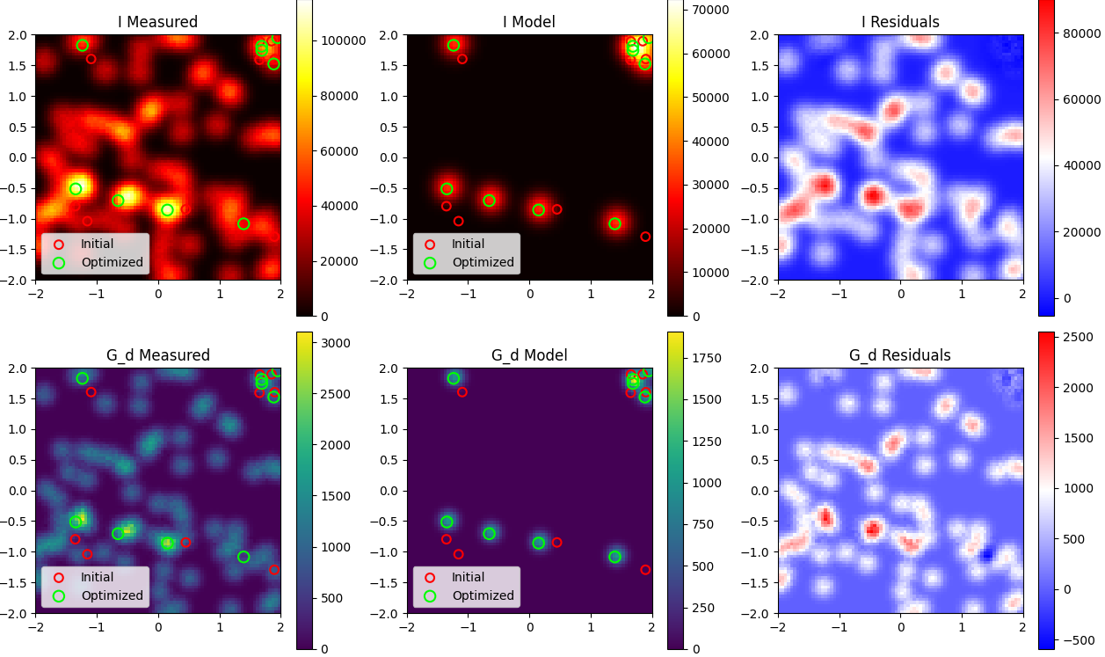
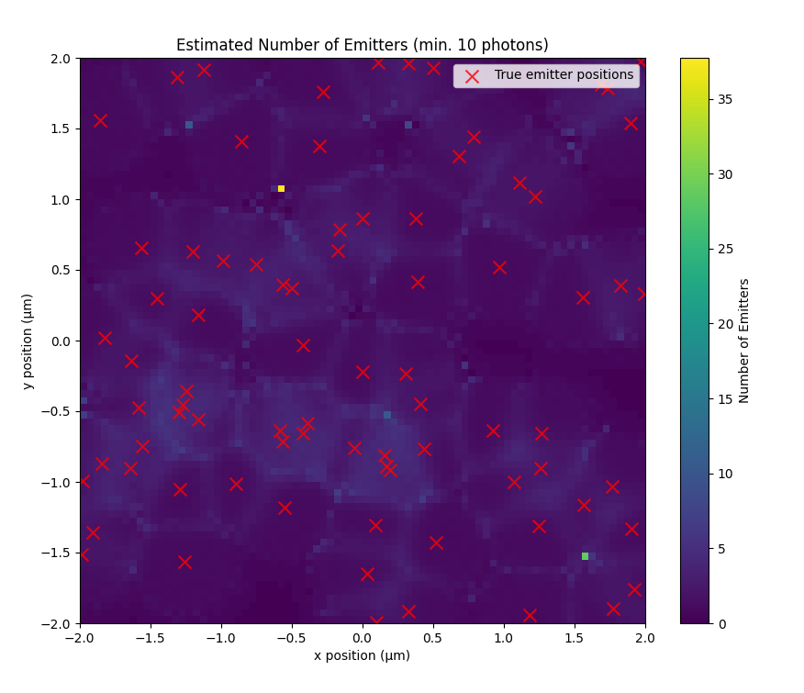
Problem: too large ROI => underestimation of n

Slide 13
Todo
Add noise to test images
How to benchmark better?
Make smaller ROI’s for large field of views? (more than 1x1 um)

